Slide 1

More Simple Algorithms: Adiabatic Evolution and QAOA
Joey Bonitati (Michigan State University)
FRIB Theory Alliance Summer School
June 20, 2022

Slide 2
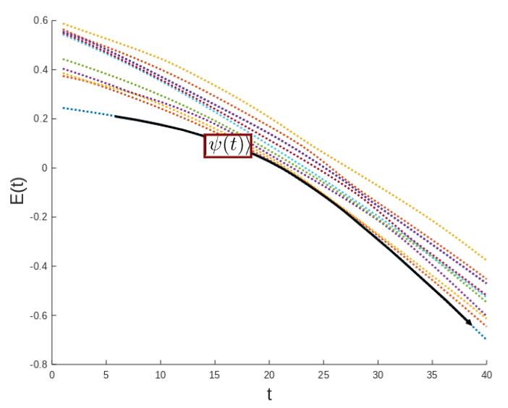
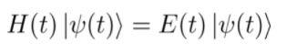
Adiabatic Theorem
An eigenstate will remain an eigenstate as long as its system is changing slowly
The smaller the energy gap between states, the slower the changes must be

Slide 3
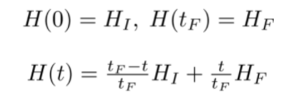
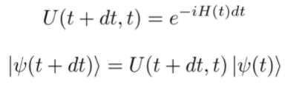
Adiabatic Evolution
Choose a simple initial Hamiltonian and final target Hamiltonian
Start in an eigenstate of H_{I} at t = 0. Apply the unitary time evolution operator
Repeat until t = t_{F}. The final state will be an eigenstate of H_{F}

Slide 4
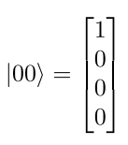
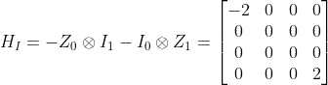
Adiabatic Evolution Example (two qubits)
Let’s choose the initial state to be:
This is the ground state of the Hamiltonian:

Slide 5
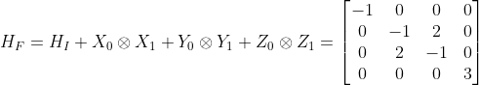
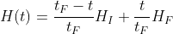
Adiabatic Evolution Example (two qubits)
For the final state, we can choose any 4x4 Hermitian matrix. For example:
The time-dependent Hamiltonian will then be:

Slide 6
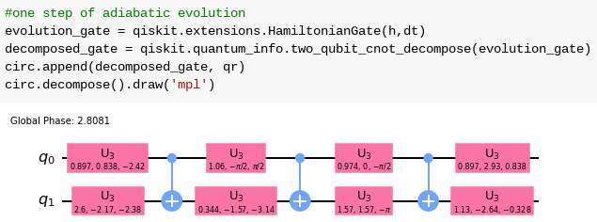
Adiabatic Evolution Example (two qubits)
Determine the time evolution gates (by hand or using qiskit library functions)
and apply them to a quantum circuit in order

Slide 7
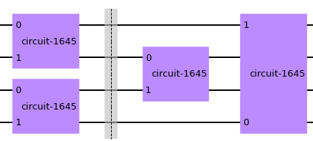
Adiabatic evolution on more than 2 qubits
If a Hamiltonian can be decomposed into a sum of 2-qubit Hamiltonians, then the Trotter approximation can be used to split the 4-qubit gate into four 2-qubit gates.
For problems with more complicated Hamiltonians and problems that require a large number of gates, methods that don’t require exact time evolution are used.
One Trotter-decomposed time evolution step on four qubits

Slide 8
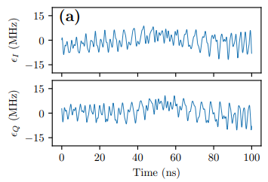
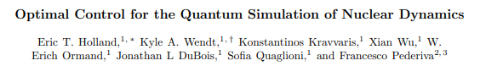
Pulse-level Control for time evolution
Can reduce the number of 2-qubit gates required to only one per time step.
Generate custom gates using classical optimization by simulating a specific quantum device

Slide 9
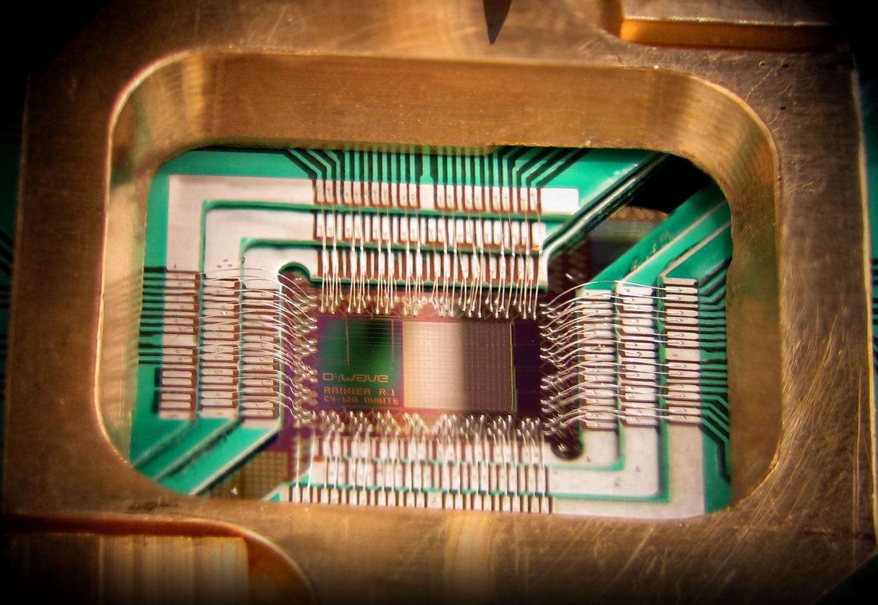
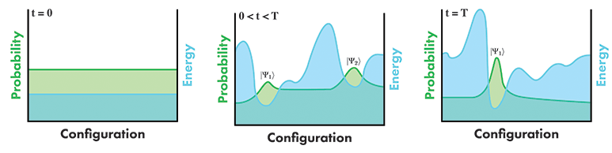
Quantum Annealing
A technique used by D-WAVE to compute ground states.
Adiabatic fluctuations are applied to a quantum system.
Quantum tunneling allows the system to settle into the ground state of a target Hamiltonian.
Currently being used to solve hard combinatorial problems

Slide 10
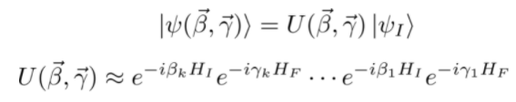
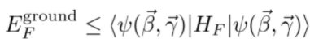
Quantum Approximate Optimization Algorithm (QAOA)
Inspired by Adiabatic Evolution
Start with the following ansatz:
We use the variational principle,
with classical optimization to find an approximate minimum energy.
QAOA can be used to approximately solve some NP-Hard problems efficiently

Slide 11
Questions

